Slide 1
Do Not Read This

Slide 2
Read This

Slide 3
sihT esraP oT yrT

Slide 4
Introduction to Quantum
Error Correction
or
Why We’re Still Here, Dr. Landauer
Error Clouds
Dave Bacon
Institute For Quantum Information
Caltech
Intel Quantum Computer

Slide 5
A Physicist Talking About
Error Correction?
Phthisis (`fθISIS)
n. A progressive wasting disease;
spec. pulmonary consumption.

Slide 6
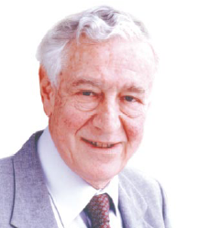
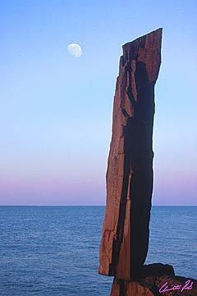
A Critical Ghost
All papers on quantum computing should carry a footnote: “This proposal, like all proposals for quantum computation, relies on speculative technology, does not in its current form take into account all possible sources of noise, unreliability and manufacturing error, and probably will not work.”
Rolf Landauer
IBM
Maintenance of giganto-coherence?
Faulty quantum gates?
Do we understand the physics of quantum errors in the system?
Nature abhors a quantum computer?

Slide 7

Quantum
Error
Correction!
Rolf Landauer
IBM
Threshold Theorem for Fault-Tolerant Quantum Computation

Slide 8




Don’t Eat That Apple
plus: simple
minus: unrealistic
plus: essential ideas
Lucifer’s channel:

Slide 9
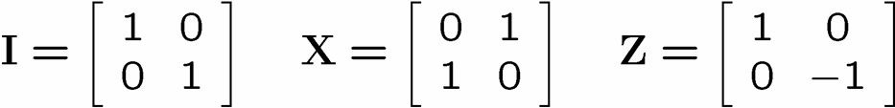





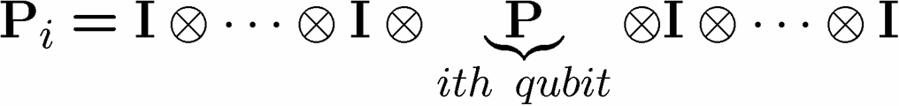
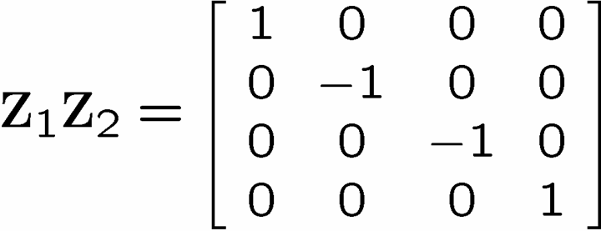
Identity

Slide 10
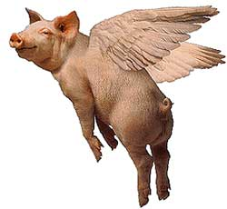
The Story of the Ghost
You are protecting your quantum information against a crazy noise model! Z₁Z₂? If this is all nature can throw at you, then pigs can fly.
Rolf Landauer
IBM

Slide 11
Noisy Cell Phone
Hello? Hello? Hello? Hello?
I have a flat tire. I said, I have a flat tire! A flat tire.
No, I’m not trying to flatter you..No, you’re not getting fatter. I have a flat tire!
Communication over a noisy CHANNEL can be overcome via
ENCODING
“Hello?” = “Hello? Hello? Hello? Hello?” [using redundancy to encode “Hello”]

Slide 12
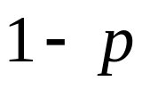
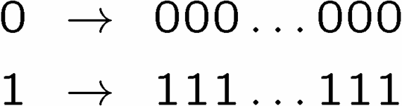

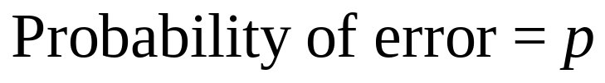
Simple Repetition Code
Encode:
0
0
n copies
1
1
No encoding:
Binary Symmetric Channel
b
measure
Encoding (n=3):
b
encode
b
b
b
decode
and correct
measure
Probability of error

Slide 13
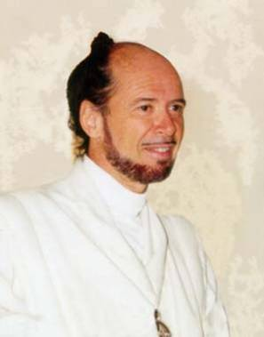





1994 Reasons to be a Pessimist
No cloning:
Quantum Cloning Machine
“A single quantum cannot be cloned,” Wootters and Zurek, Nature, 1982
No quantum repetition code:
Measurement destroys coherence:
How can one decode without destroying the information?

Slide 14

Unrealistic Realistic Channel

Slide 15
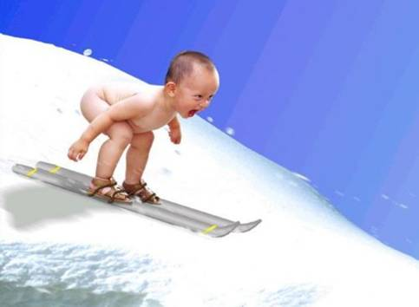
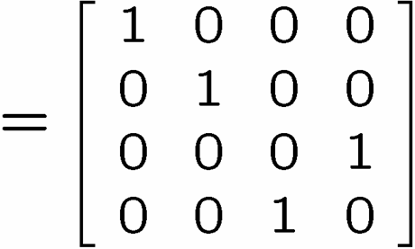
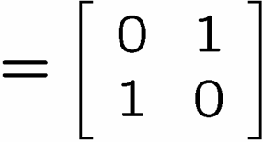
Baby Steps
WWCCD? (What Would Classical Coders Do?)
measure
b
b
0 →000, 1 → 111
0
b
0
b
encode
error
decode
fix
100 → 111→101 → 110 → 110
identities
b
b
=
b
1
0
1
1
1
=
0
error #@%

Slide 16



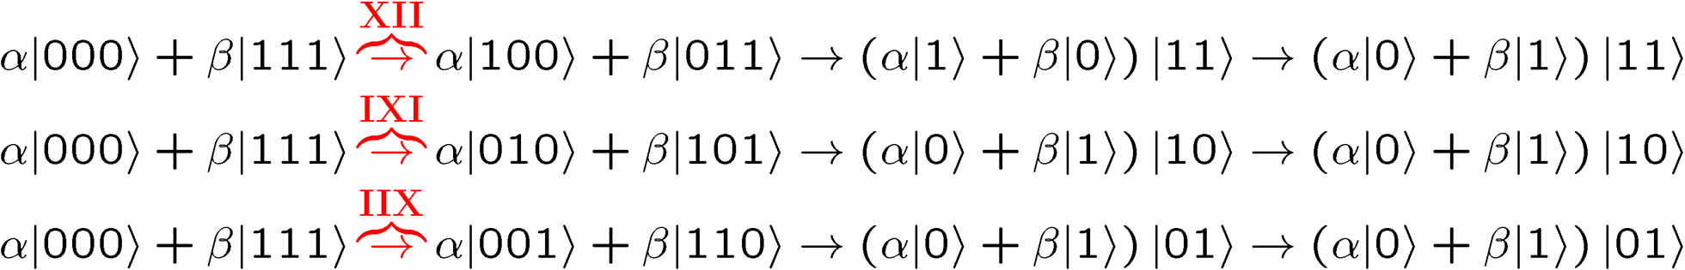
Naïve
4. operator identities still hold
Lets be naïve, take classical and move over to quantum
encode
error
decode fix
?
error
decode
fix
encoded into subspace:
2. errors take to orthogonal
subspaces + maintain orthogonality
3. syndrome
(no-cloning evaded!)

Slide 17






Identity
encode
error
decode fix

Slide 18
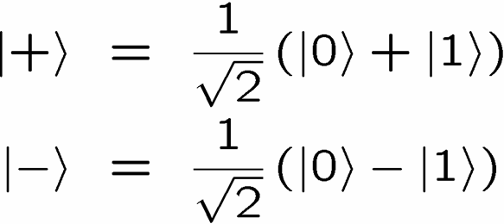
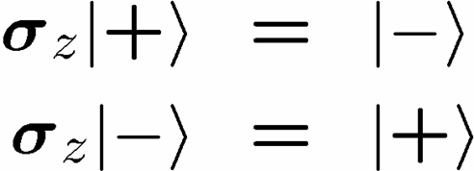


OK Wise Guy
What about “phase” errors?
…sort of not classical error
phase error:
Wise guy says “basis change please”:
looks like bit flit error in this new basis!
H
H
H
H
H
H
phase errors
bit flip errors

Slide 19
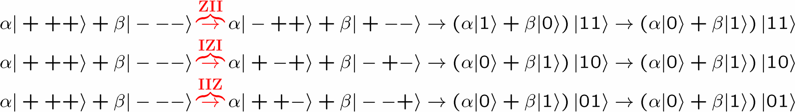
Molly: “I love you, I really love you”
Sam: “Ditto.”
encode
error
decode
fix
H
H
?
H
H
H
H
error
decode
fix
encoded into subspace:
2. errors take to orthogonal
subspaces + maintain orthogonality
3. syndrome
(no-cloning evaded!)

Slide 20


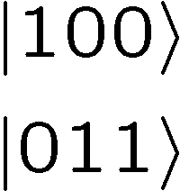




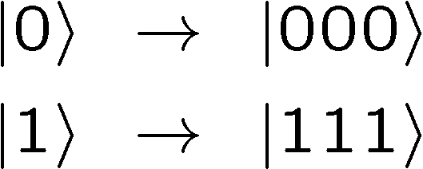

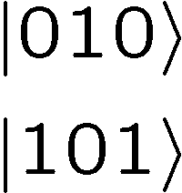



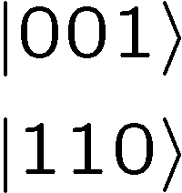

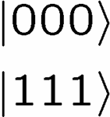
Perspective
Orthogonal subspaces can be distinguished by measurements
without measuring information encoded into the subspace!!!

Slide 21

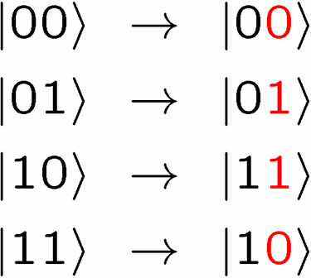
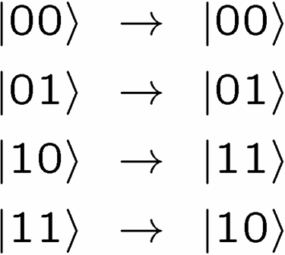



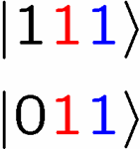
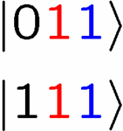
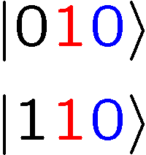
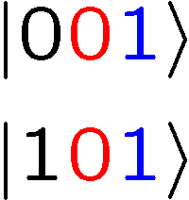
Not An Optical Illusion
fix
error

Slide 22
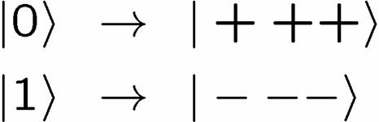


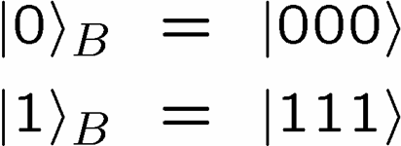
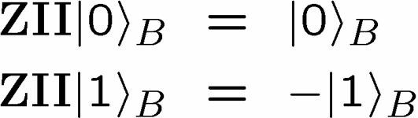
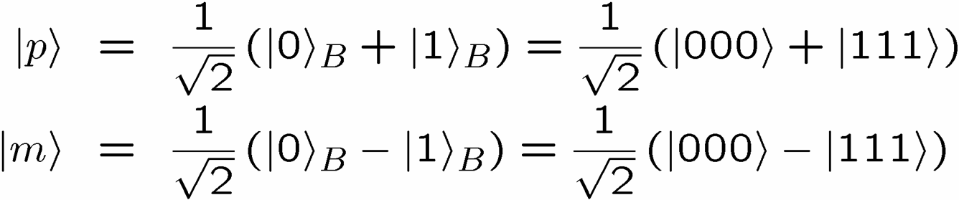
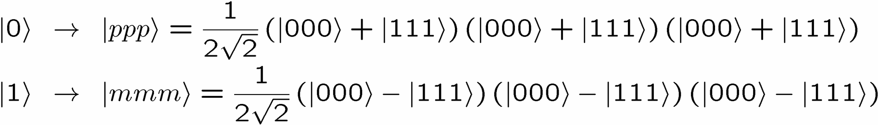
Encoding Away Your Ills
3 qubit bit flip code
3 qubit phase flip code
phase errors act as on bit flip code qubits:
define:
Shor Code: (Peter Shor, 1995)

Slide 23
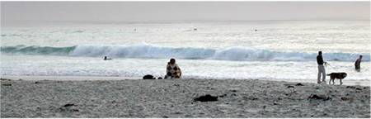


Inside Shor
H
H
H
H
H
H
bit flip code
phase flip code

Slide 24
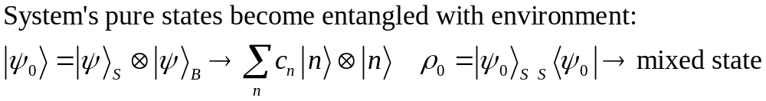
What is the Problem?
Real quantum systems are open quantum systems!
system
environment
Full Hamiltonian:
Interaction causing
DECOHERENCE
System evolution
environment evolution
System evolution (by itself) is no longer unitary
Coherent properties of system’s quantum information lost

Slide 25


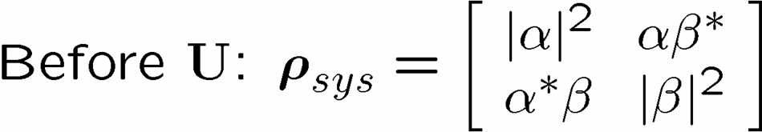

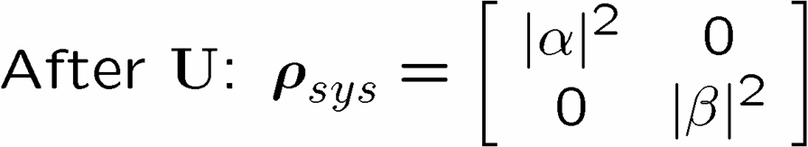
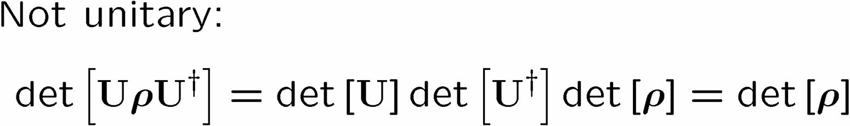
Quantum Error Example
“To err is human, to really foul things up requires a computer.” -Anonymous
system
environment

Slide 26





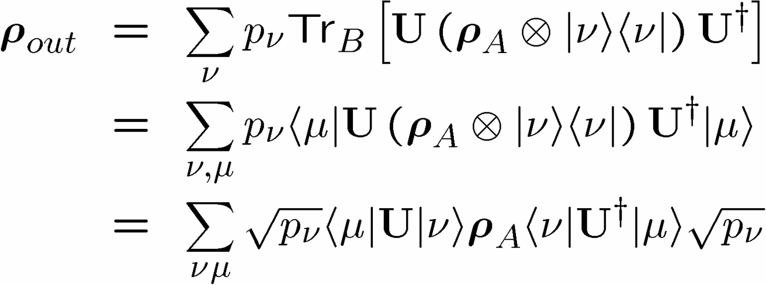
Operator Sum Representation
U
B states

Slide 27


OSR Facts

Slide 28
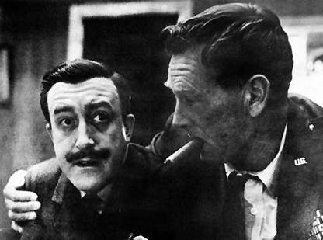


Purification Simplification
U
Purification of system B
U
Purification of system B

Slide 29

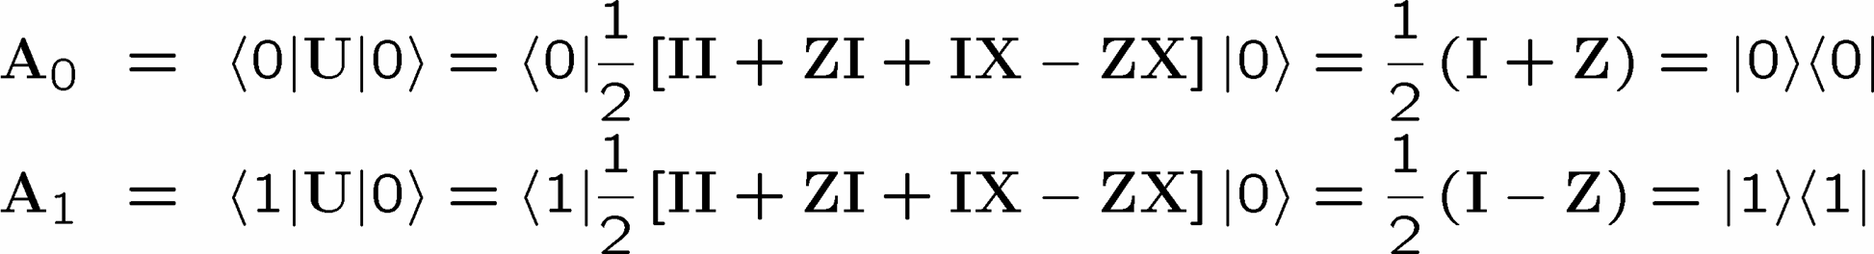
OSR Example
U

Slide 30
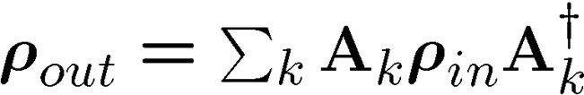


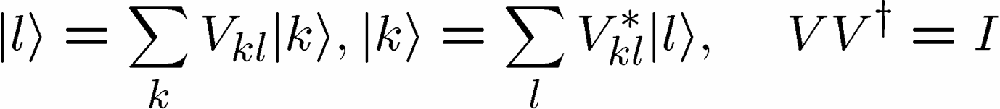
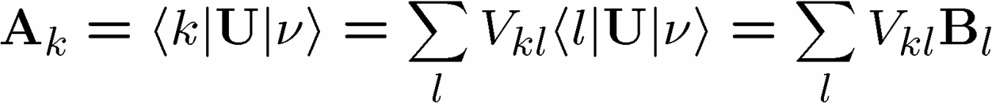
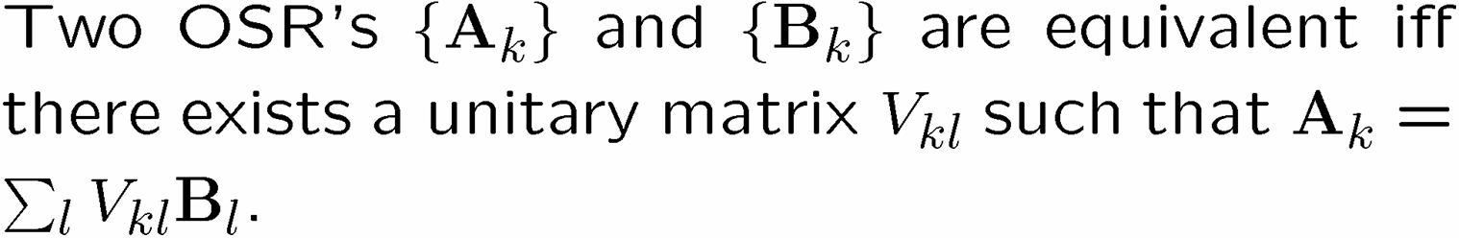
OSR Unitary Freedom
U
U
V
Equivalent from system A’s perspective

Slide 31








Do the Hokey Pokey
Take a step back:
encode
error
diagnose
error
fix
encode
Here quantum information has simply been encoded into
Then an error occurs
Then a recovery procedure
An miraculously we recover the encoded state

Slide 32
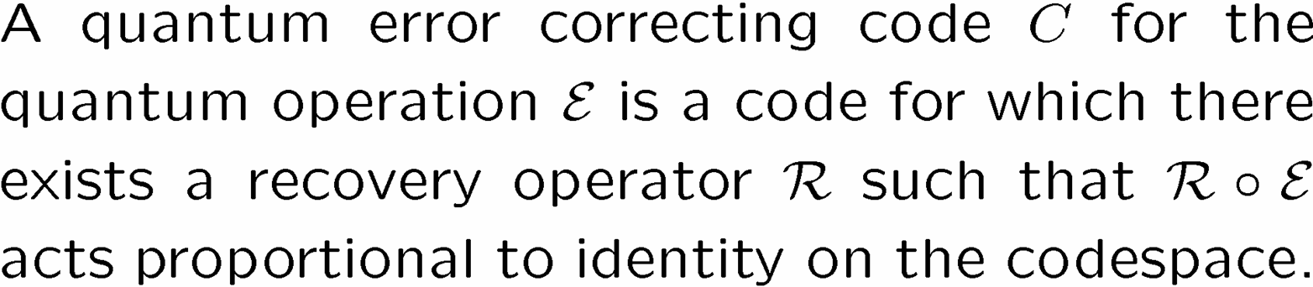
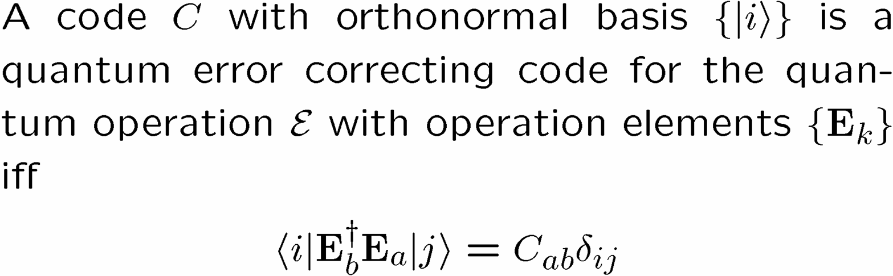
Lets Get Definitional
subsystem
Quantum Error Correcting Code
Iff Condition for Quantum Error Correcting Code

Slide 33
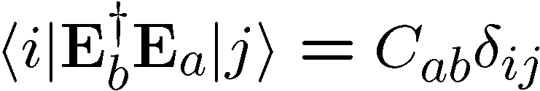


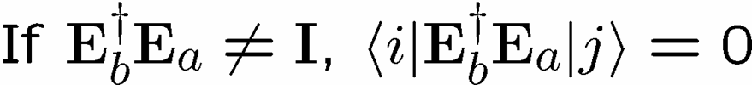
In Action

Slide 34

Diagonal Error Condition

Slide 35

Pictures
Orthogonality maintained
Orthogonality not maintained
codespace
Orthogonal subspaces
Errors not distinguishable
BAD
GOOD

Slide 36
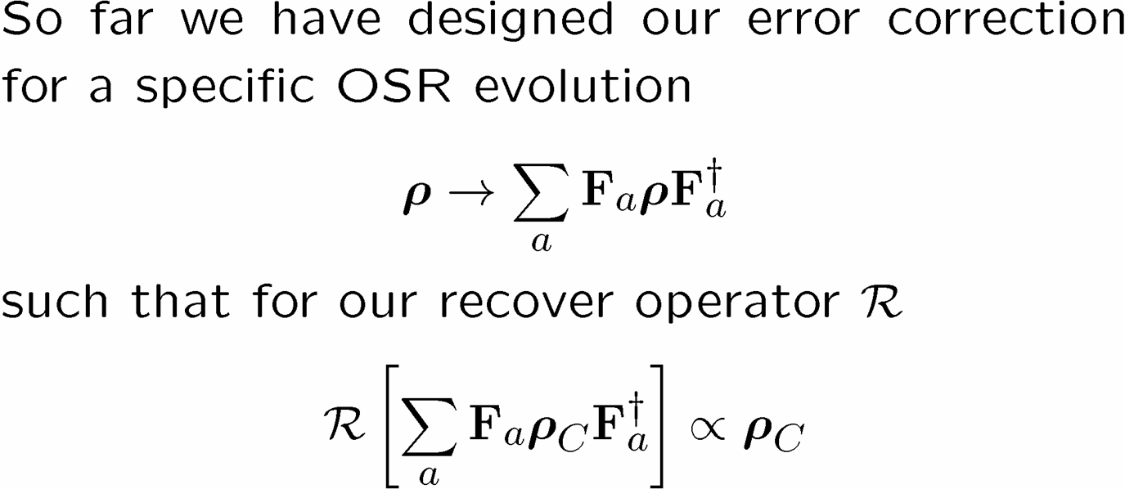

1994 Reasons to be a Pessimist
Continuous set of errors:
Classical errors on digital information are discrete.
Quantum errors on classical information are continuous.

Slide 37




How Have We Helped?

Slide 38
Independent Error Model
WARNING: “An approximation only a physicist could love.”
qubits/subsystems
local environments
Evolution dominated by interaction with different environment modes which do not interact with each other:
Notion of “no error probability” gives credence to standard argument for error correction success.
Really we can weaken this requirement (exponentially decreasing correlation [time and space] between errors).

Slide 39



Perfection Through Concatenation
U
V
U
Threshold Theorem for Quantum Memory

Slide 40

Review
Maintenance of giganto-coherence?
Rolf Landauer
IBM
Iff Condition for Quantum Error Correcting Code

Slide 41
The Next Episode
Actual error correcting codes!
Stabilizer formalism and codes
Topological quantum computation

Slide 42


“Dave, may I be excused? My brain is full.”

